Slide 1

Session 2
Locators

Slide 2
Knowledge Check
Session 1
Why Java to be used for Selenium WebDriver?
Does Selenium Supports Automation of Windows App? If yes, How?
In what situation we should use Selenium IDE?
Difference between Verify and Assert.
What is Change Log?

Slide 3
Topics
Covered
What are locators?
Types of locators
Locate elements by ID
Locate elements by Name
Locate elements by Link
Locate elements by CSS
Locate elements by DOM
Locate elements by XPath

Slide 4

What are
locators?
Locator is a command that tells Selenium IDE which GUI elements ( say Text Box, Buttons, Check Boxes etc) its needs to operate on.
Identification of correct GUI elements is a prerequisite to creating an automation script.

Slide 5
Types of
locators
Types of locators:
  ID
  Name
  Link Text
  CSS Selector
  DOM (Document Object Model)
  XPath

Slide 6
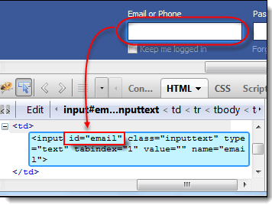
Locate elements
by ID
This is the most common way of locating elements since ID's are supposed to be unique for each element.
PROS:
  Each id is supposed to be unique so no chance of matching several elements
CONS:
  Works well only on elements with fixed ids and not generated ones

Slide 7
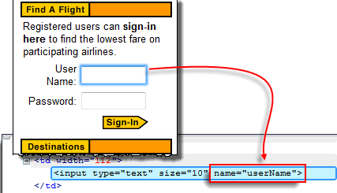
Locate elements
by Name
Locating elements by name are very similar to locating by ID, except that we use the "name=" prefix instead.
PROS:
  Works well with fixed list of similar elements
CONS:
  Difficult to use with data-bound lists

Slide 8
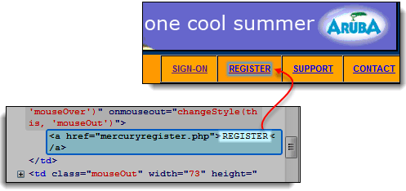
Locate elements
by Link
This type of locator applies only to hyperlink texts. We access the link by prefixing our target with "link=" and then followed by the hyperlink text.
PROS:
  Will only select anchor elements
  Useful when testing navigation
CONS:
  You have to know the text of the link before

Slide 9
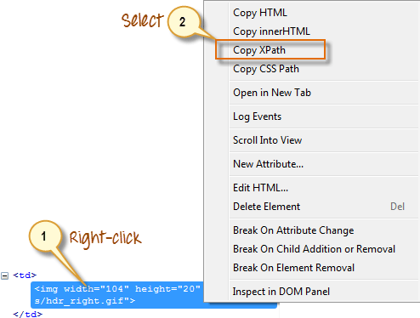
Locate elements
by CSS
CSS Selectors:
  Element based on a combination of HTML tag, id, class, and attributes.
  More complicated
  Can access even those elements that have no ID or name.
PROS:
  Provides a good balance between structure and attributes
  Allows for selection of elements by their surrounding context
CONS:
  They tend to be more complex and require a steeper learning curve

Slide 10
Locate elements
by DOM
The Document Object Model (DOM), in simple terms, is the way by which HTML elements are structured.
  There are four basic ways to locate an element through DOM:
    document.getElementById(“id”)
    document.getElementsByNames(“name”)[index]
    dom:name (applies only to elements within a named form)
    dom:index (applies only to elements within a named form)
PROS:
  Javascript allows you to build dynamic locators
CONS:
  Relies on the structure of the page

Slide 11
Locate elements
by XPath
XPath is the language used when locating XML (Extensible Markup Language) nodes. Since HTML can be thought of as an implementation of XML, we can also use XPath in locating HTML elements.
PROS:
  Allows very precise locators
  It can access almost any element, even those without class, name, or id attributes.
CONS:
  Relies on browser’s XPath implementation.

Slide 12


Slide 13
Knowledge Check
Firefox plugin for identification of elements?
What are the type of locator we discussed?

